Slide 1
IPL Match Winner Prediction-ML
R.PRAVEEN
DA & DS
MAY - 2025

Slide 2
Introduction
Problem Definition: Building a best model to predict the IPL winner with good evaluation metrics scores and performance.
Dataset: Numerical and Categorical columns with many key factors.
Objective: Predicting IPL winner based on input features by using ML models and choose a best model.

Slide 3
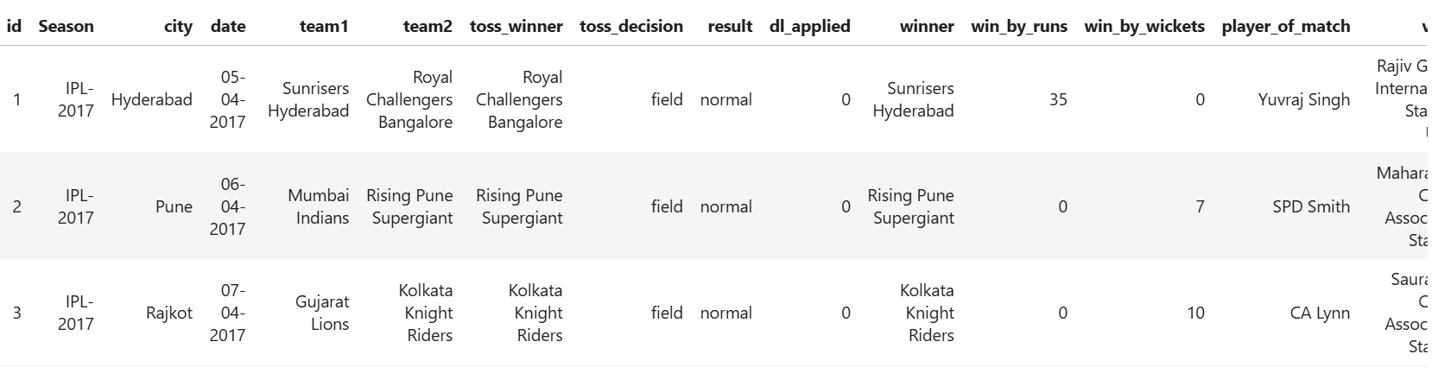
Data Understanding
Dataset with 756 rows and 18 columns

Slide 4
Data Cleaning
Umpire 3 has 84% of missing values.
Dropped Umpire columns, id, player of match, result, date.
Handled missing values in winner, city.
Rectified Inconsistent values.
Used One-Hot Encoding
Label Encoding

Slide 5
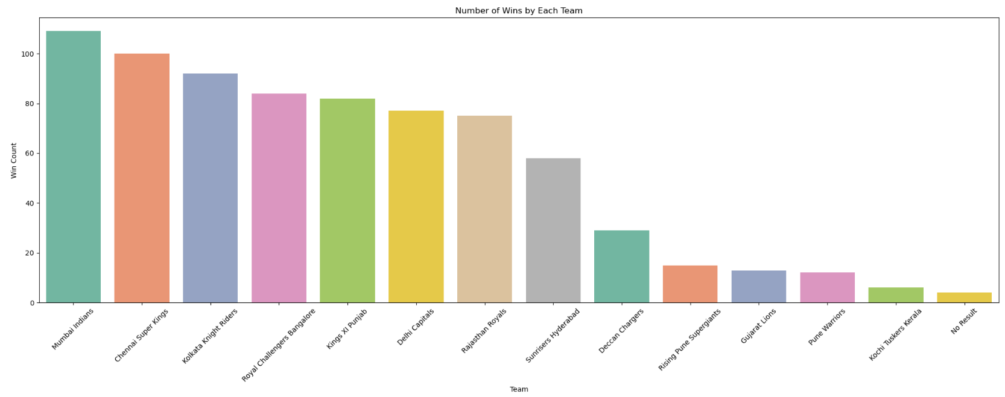
Exploratory Data Analysis

Slide 6
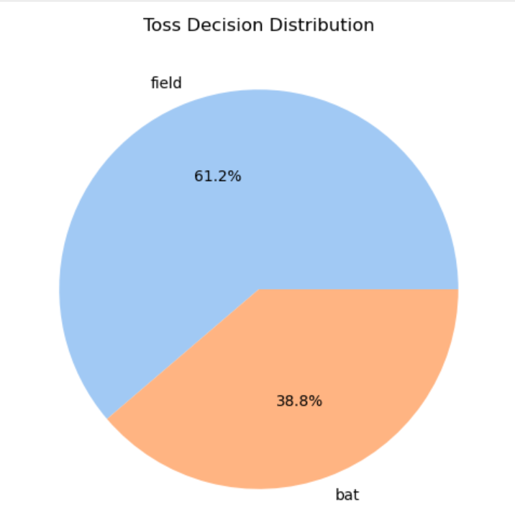
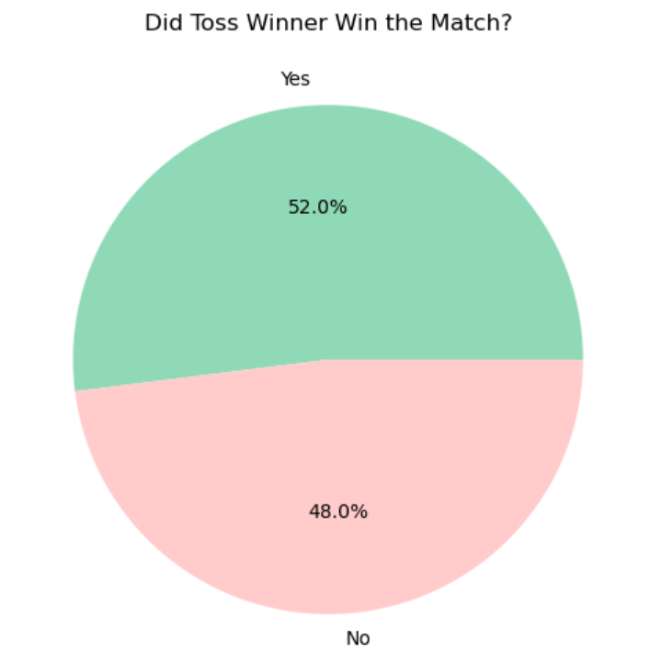
Visualizations

Slide 7
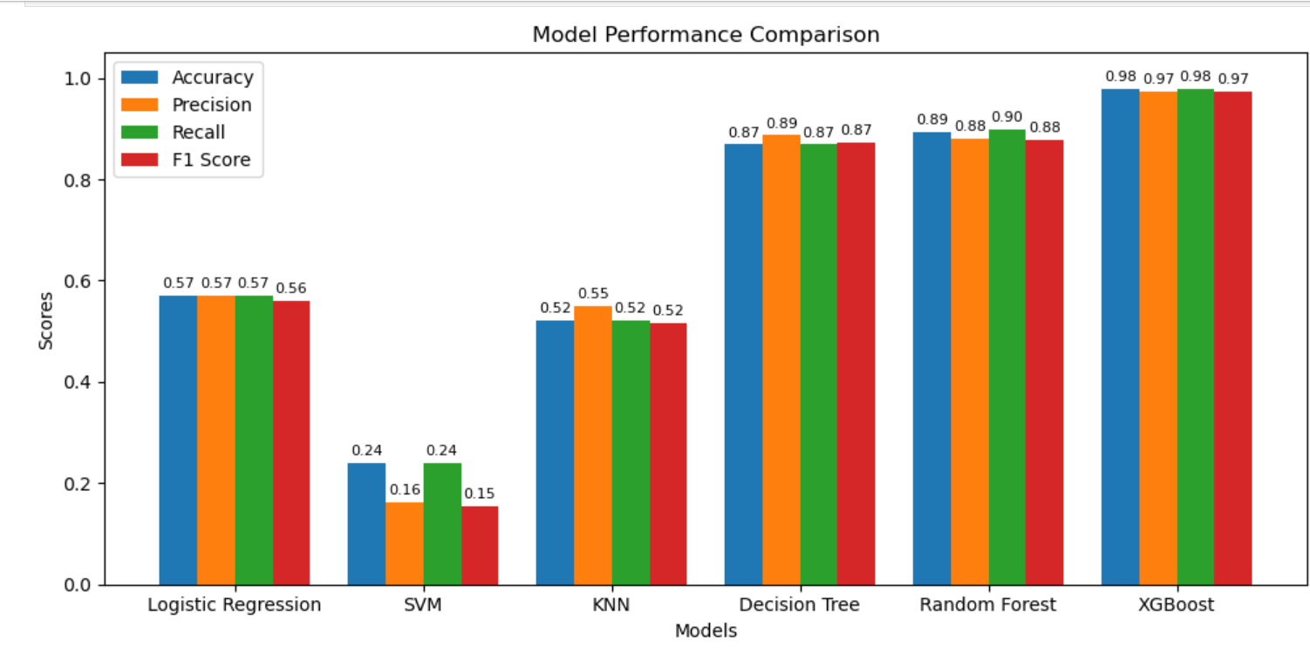
Model Comparison

Slide 8
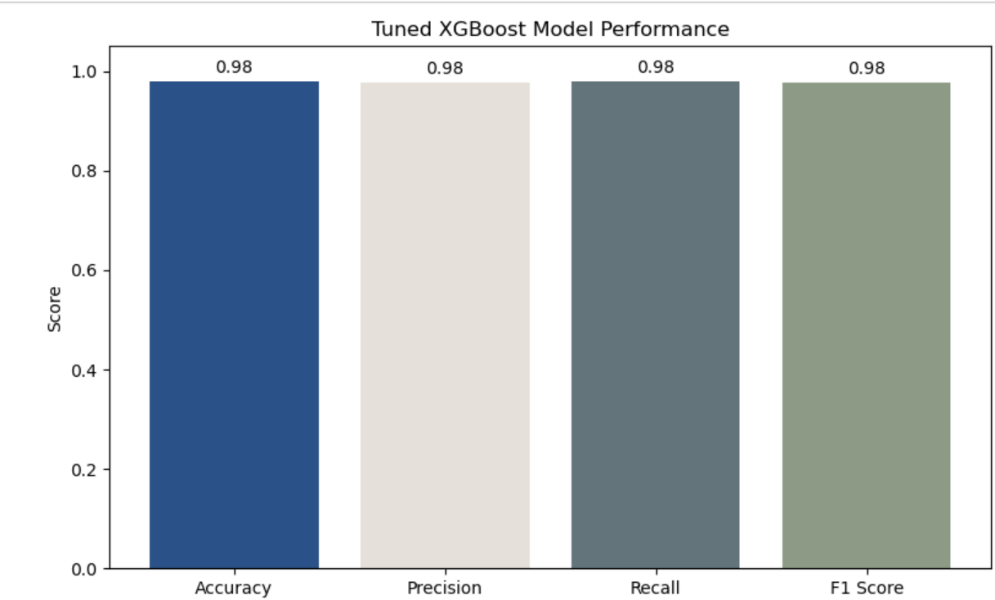
Best Performing Model - XGBoost

Slide 9
Insights from EDA
Mumbai Indians won 110 matches followed by Chennai Super Kings with 100 wins.
61% of teams choosing Bowling after winning the toss.
Toss winning team have 52% of winning rate to win the match.
100 matches are played on Mumbai City followed by Kolkata and Delhi.
Most of the teams winning the match by the margin of 6 wickets.
Toss winner impacting the Match winner.

Slide 10
Conclusion
Improvement: Advanced Hyperparameter Tuning-Bayesian Optimization
Continuous Learning
Model Monitoring
Possible Future Steps: Collect More Data
Live Match Predictions

Slide 11
THANK YOU

